Slide 1




DR. JONATHAN SCHLER
Ohad Edry & Meital Haronyan
Flights price ticket
Data Mining and Machine Learning final project

Slide 2


Research question:
Is it possible to predict the price of airline tickets?

Slide 3


Main Steps
Defining the problem
Identify appropriate data
Preliminary analysis
Methods and algorithms
performance appraisal
Visualization
Conclusions

Slide 4


Defining the problem
Is it possible to predict the price of airlines tickets?
Towards a return to routine and the possibility of traveling abroad, a flight to a vacation is on the minds of all of us. We decided to research the issue of flight prices. We chose one of the most common countries to travel among guys our age - India.

Slide 5


We used one dataset :
Identify appropriate data
Our DataSet

Slide 6
Preliminary analysis
Make sure we have the right amount of data
Reading our dataset with openpyxl module
we checked also -
statistics of missing value - For most of the flights there was no detail provided

Slide 7


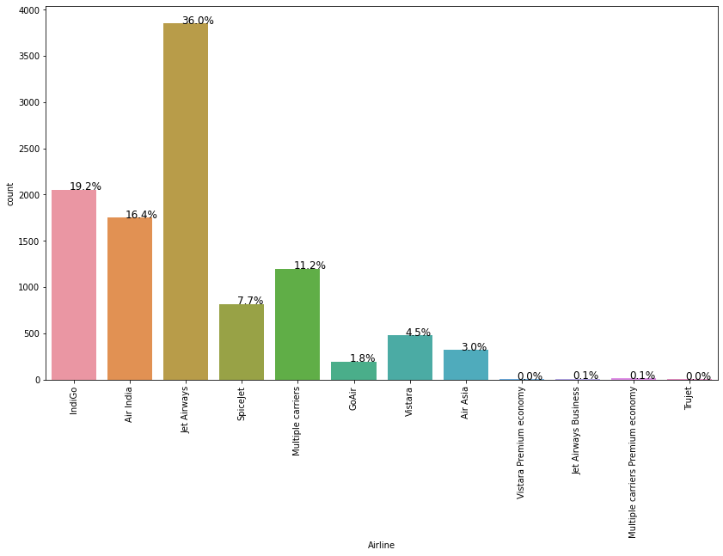
Visualization
Number of flights by company
We can see that Jet Airways sells the highest amount of tickets

Slide 8
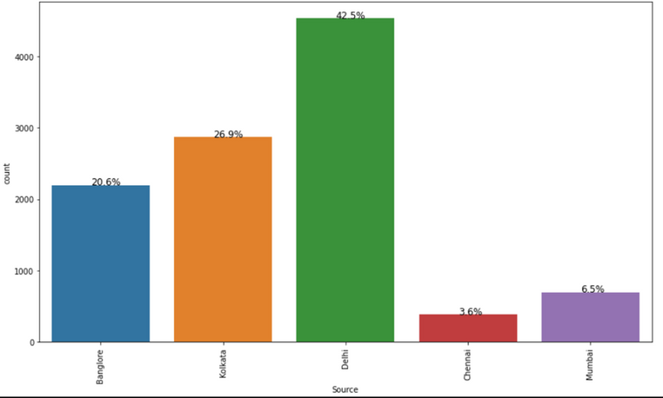
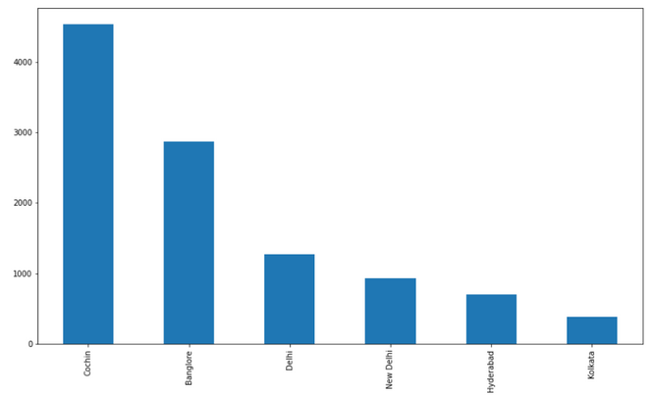
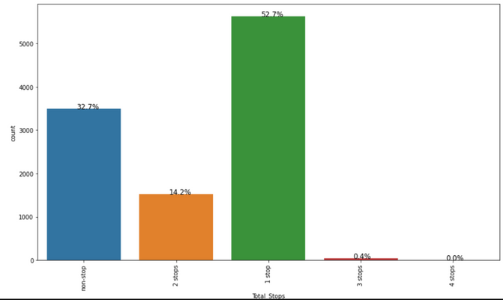
Visualization
Flights information
Most flights were Take Off from Delhi state in india
&
Most flights were having destination to Cochin city
&
Almost 53% flights made only one stop during their journey

Slide 9
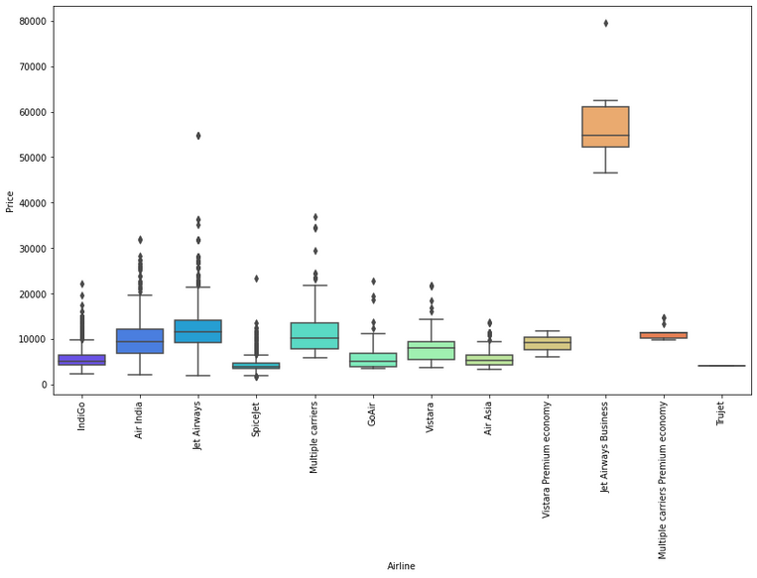
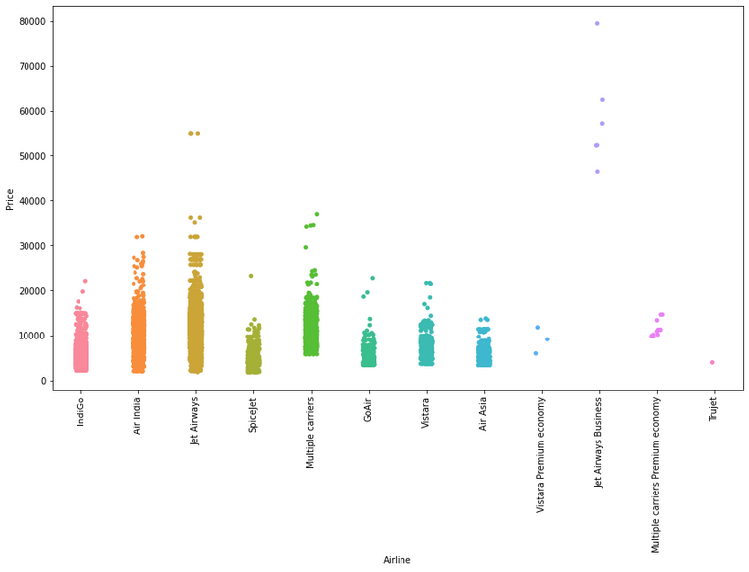
Visualization
Prices information
we can see that the fare range of almost all Airlines is between 1000 to 30000

Slide 10
Methods and Algorithms
Advanced data analysis
47.17 %
76.38 %
83.45 %
76.38 %
Linear Regression
K-Nearest Neighbors
Decision Tree
Random Forest
Create a model that predicts the value of the variable. A tree can be seen as a permanent approximation
Construction of a large number of deciduous trees
A method used to analyze statistical samples
An algorithm that is close, lacks parameters. The input depends on k observations and can be used for classification or regression

Slide 11
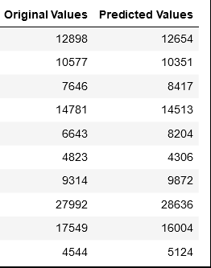
performance appraisal
We can see that there is much difference between predicted and original values
That's mean our performing better
We made some predictions for test data with our finalized model Decision Tree

Slide 12


Conclusions
Success!
Our project was to predict the fare of different airlines. first we read the data. Dataset was having more then 10,000 records. That wasn't clean. There were some missing values that have been dropped. Then we Performed Visualization to get interesting insights from data. we wrote these insights under every graph.
After that we performed Feature Engineering to encode them to integer values and select the best one of them.
Then that, it was time to built the model. We prepared and fit 4 models to find best one. And we can see that Decision Tree was performing much better than other models. It was giving accuracy around 85% that is an ideal accuracy in case of regression.
In end to test model we also made some predictions and results are very close to original values.

